Slide 1
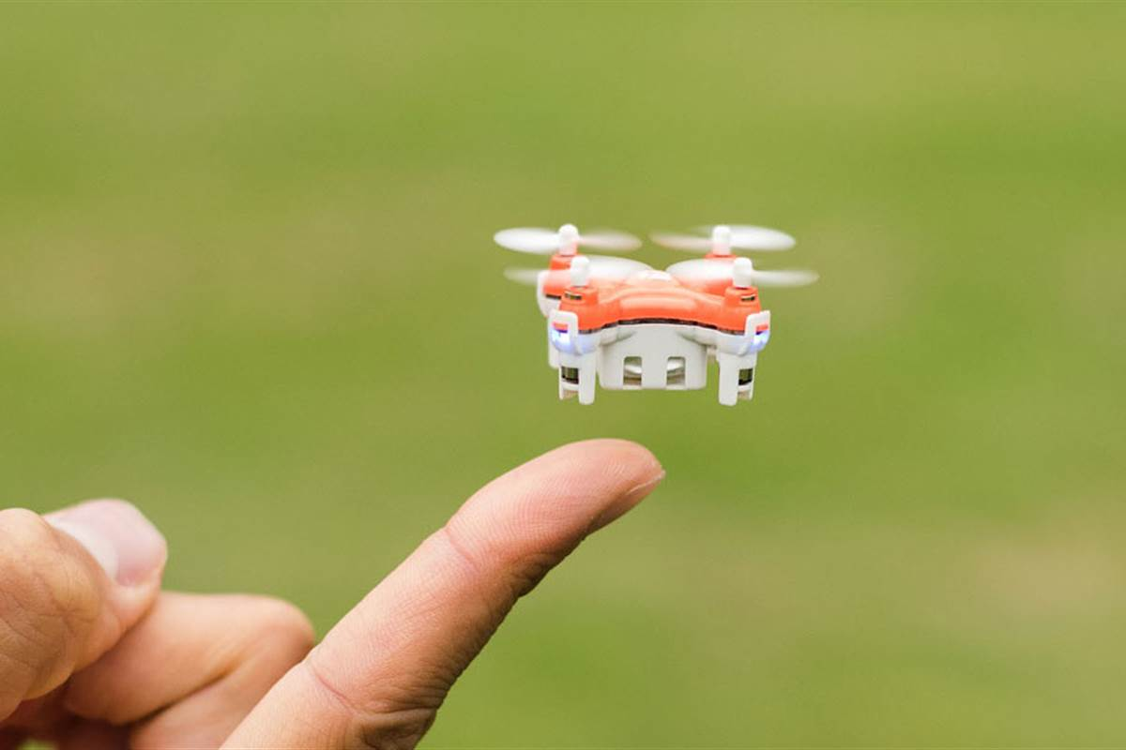
DRONE??
What is it??

Slide 2
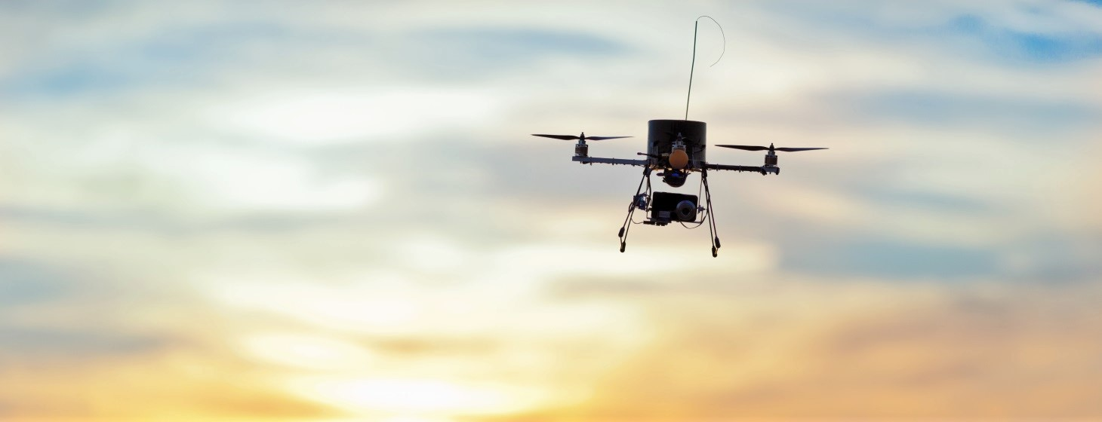
A Flying ROBOT!
UAVs have mostly used for
MILITARY,
Search,
Rescue,
Surveillance,
Traffic Monitoring,
Weather Monitoring
Firefighting, and among other things.

Slide 3

Problem! CRASHING OF DRONE REASON? wind, water, ice, or objects in the air. At times, drones have accidentally flown into No-Fly Zones or restricted airspace Often the vehicles are damaged beyond repair and destroy many lives..

Slide 4
Solution? ☺
An Application Under
DON’T CRASH MY DRONE
Which features:
Weather parameters of wind speed and direction, gust speed potential, dew point, temperature and visibility.
Zoom-capable Imagery of vegetation, buildings, poles and wires, communication towers; bodies of water
Known No-Fly Zones or Restricted airspace within a five-mile radius.

Slide 5
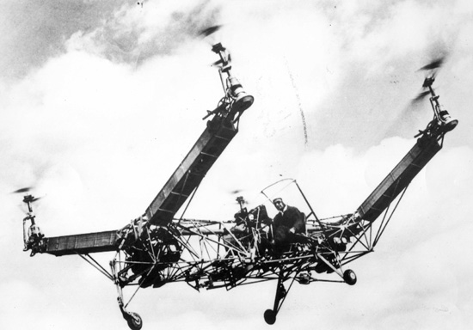
How?
HOW??

Slide 6
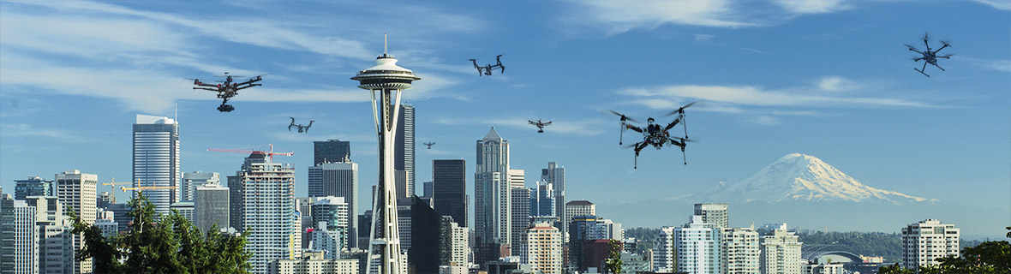
Integrating the weather API with our
application
Storing the MAPS
Introducing the RTL feature

Slide 7
What makes it Different?

Slide 8
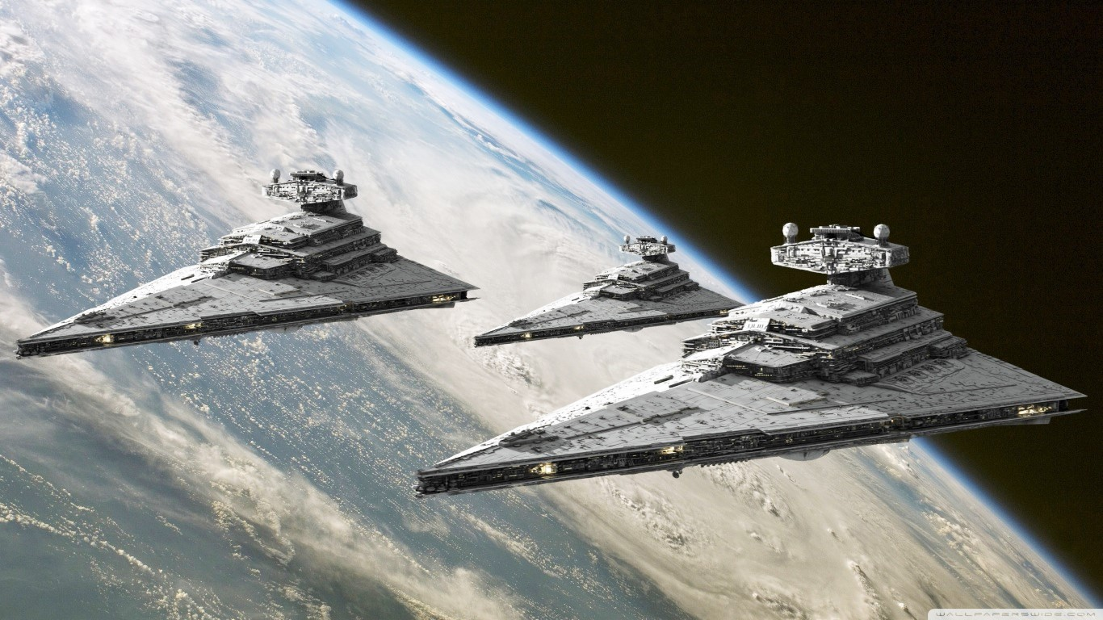
This is an application which can be used anywhere
just by changing respective Data Sets
And the RTL function

Slide 9
What Next?

Slide 10
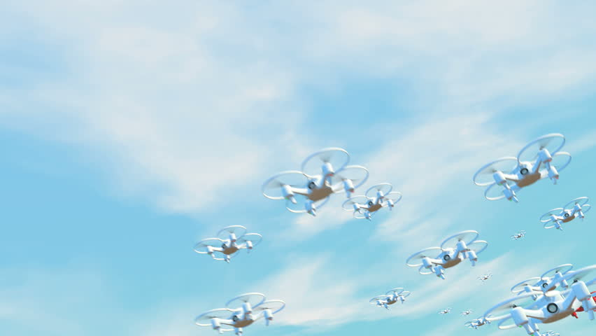
When filmmaker George Lucas popularized droids worker robots designed to tend to humanity's every need.
In the 1977 movie "Star Wars: Episode IV - A New Hope," he seemed like a sci-fi visionary.
But fast-forward nearly 40 years, and the idea of flying surveillance cameras,
robotic companions and
even unmanned aircraft
carrying supplies around the planet is swiftly becoming
mainstream.

Slide 11
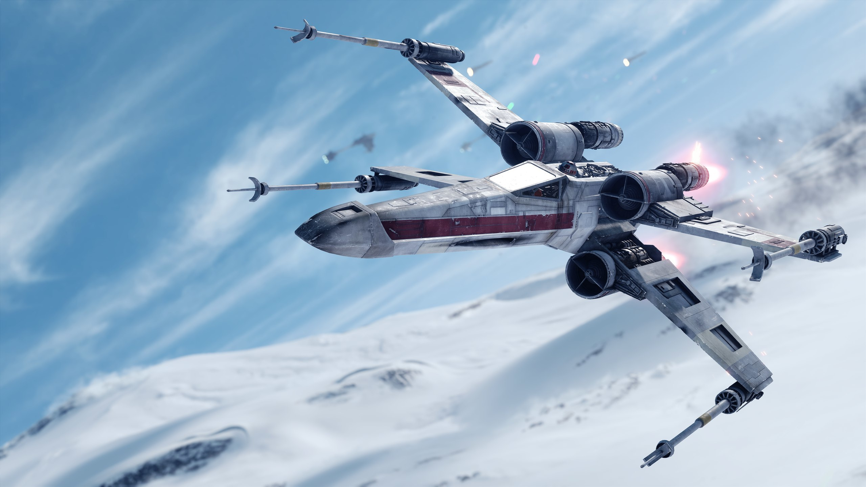
Mobility anywhere
and everywhere with
minimum
possibility
of crashing
Self defense of the Drones
Saving lives

Slide 12
THANK YOU! ☺

